Slide 1
Zero Touch Provisioning & Configuration Management of Cisco FTD in Azure
Using Terraform and Ansible
Ed McNicholas
Sr. Cybersecurity Architect
@don’t have one
DEVNET-2150

Slide 2

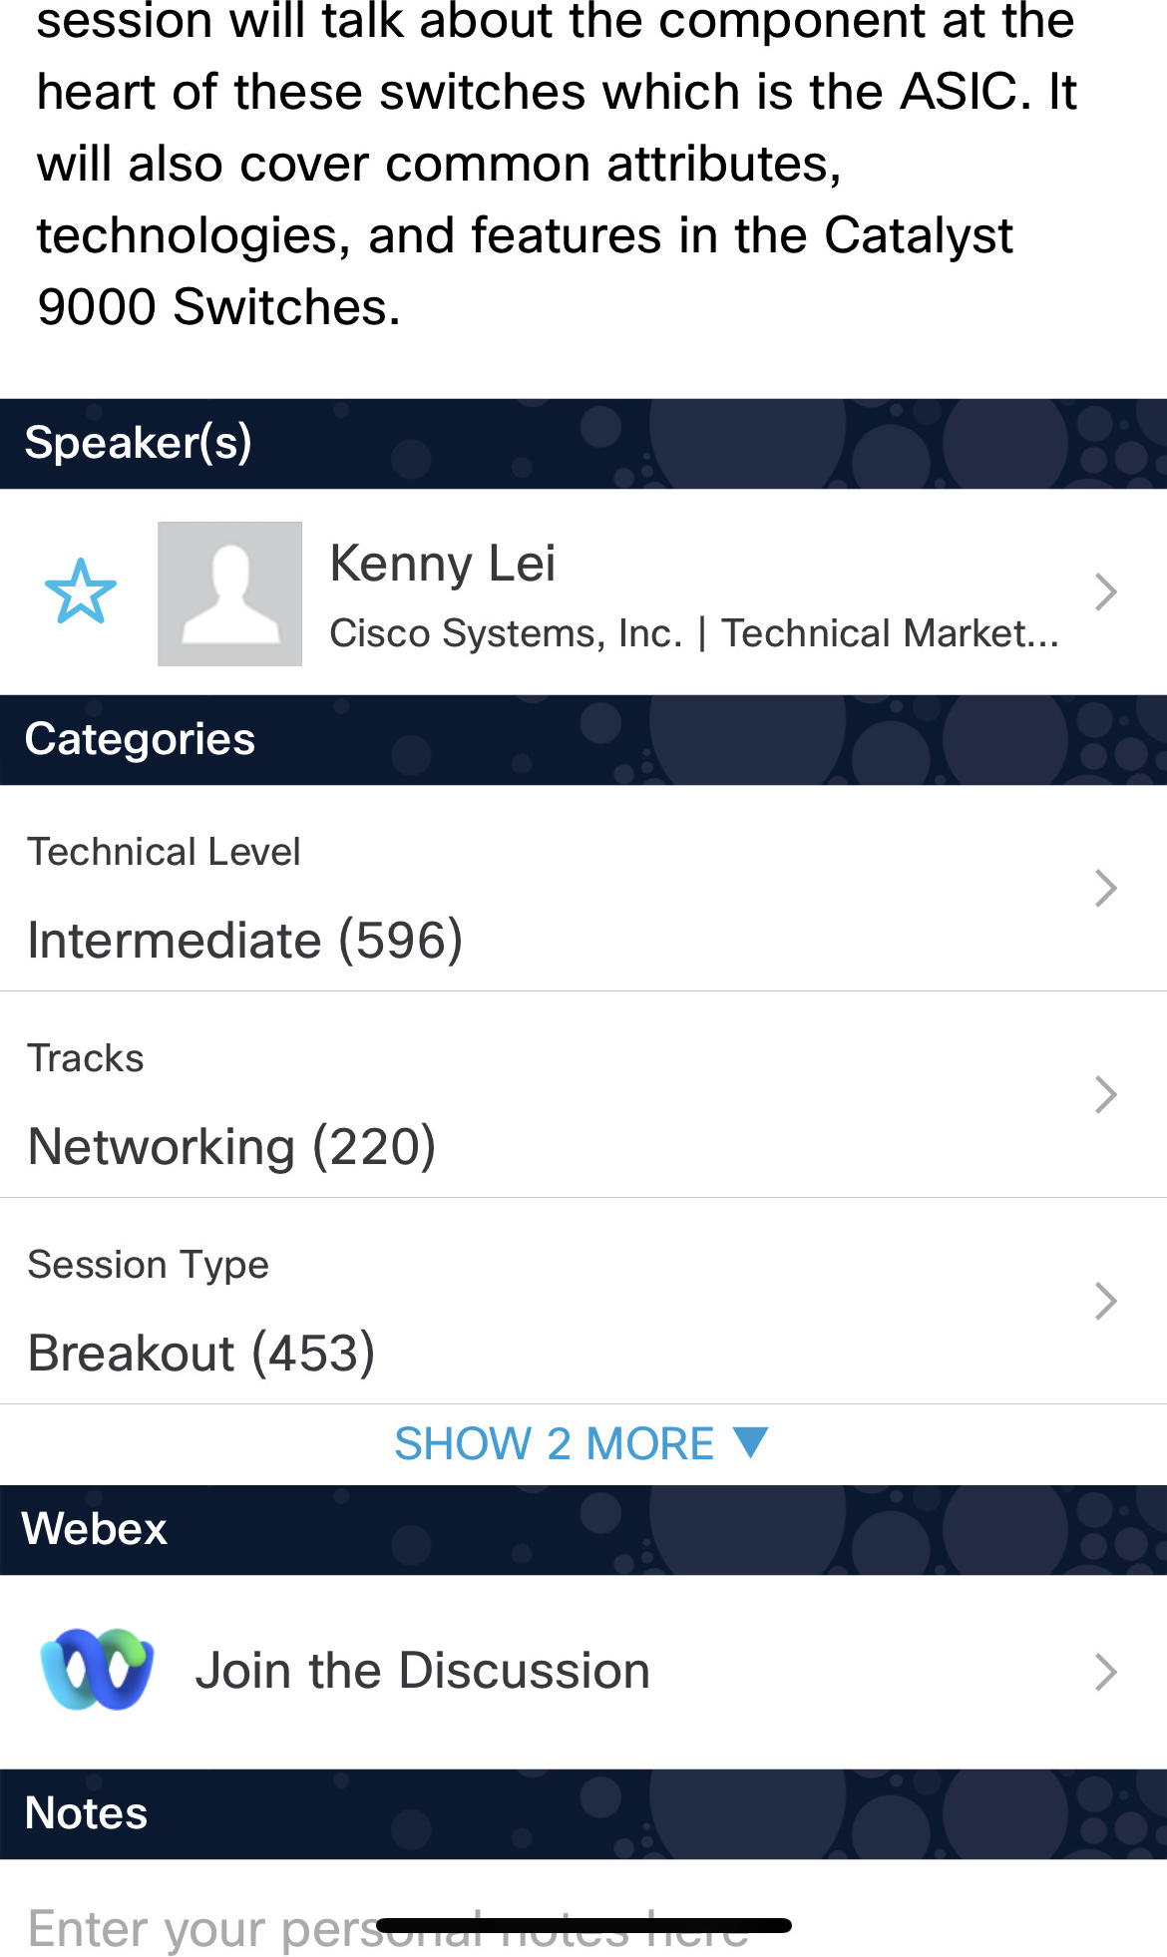

Webex App
Catalyst 9000 Series Switching Family - …
Questions?
Use Webex App to chat with the speaker after the session
How
1
Find this session in the Cisco Events App
Click “Join the Discussion”
Install the Webex App or go directly to the Webex space
Enter messages/questions in the Webex space
2
3
4
Webex spaces will be moderated by the speaker until February 27, 2026.
Enter your personal notes here

Slide 3
Agenda
Introduction
Azure
Terraform
Ansible
Conclusion

Slide 4
Introduction

Slide 5





Automating FTD in Azure
Azure
Terraform
Secure
Firewall
Security Cloud
Control
Ansible
GitHub Repo - https://github.com/emcnicholas/Azure_TF_GWLB.git

Slide 6
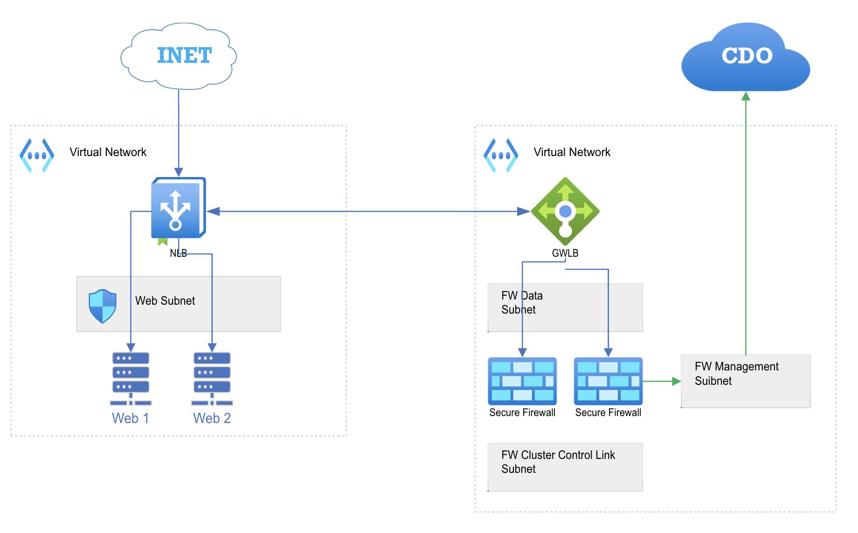
The Architecture

Slide 7

Before diving in headfirst Let's talk terminology

Slide 8

Ansible – Imperative & Mutable
Shallow Learning Curve
Agentless
Supports Every Device from Every Vendor
Modular
Open-Source Community and Vendor Commercial Support
Common Toolset with server / DevOps / infra teams

Slide 9


Terraform – Declarative & Immutable
Developed by HashiCorp
Initial release in July 2014
Designed to be a full Infrastructure as Code (IaC) management tool for Cloud Infrastructure Provisioning
Completely written in Go, creating a single binary file
Fully declarative leveraging HashiCorp Configuration Language (HCL)
Notes:
Cloud Network Provisioning

Slide 10
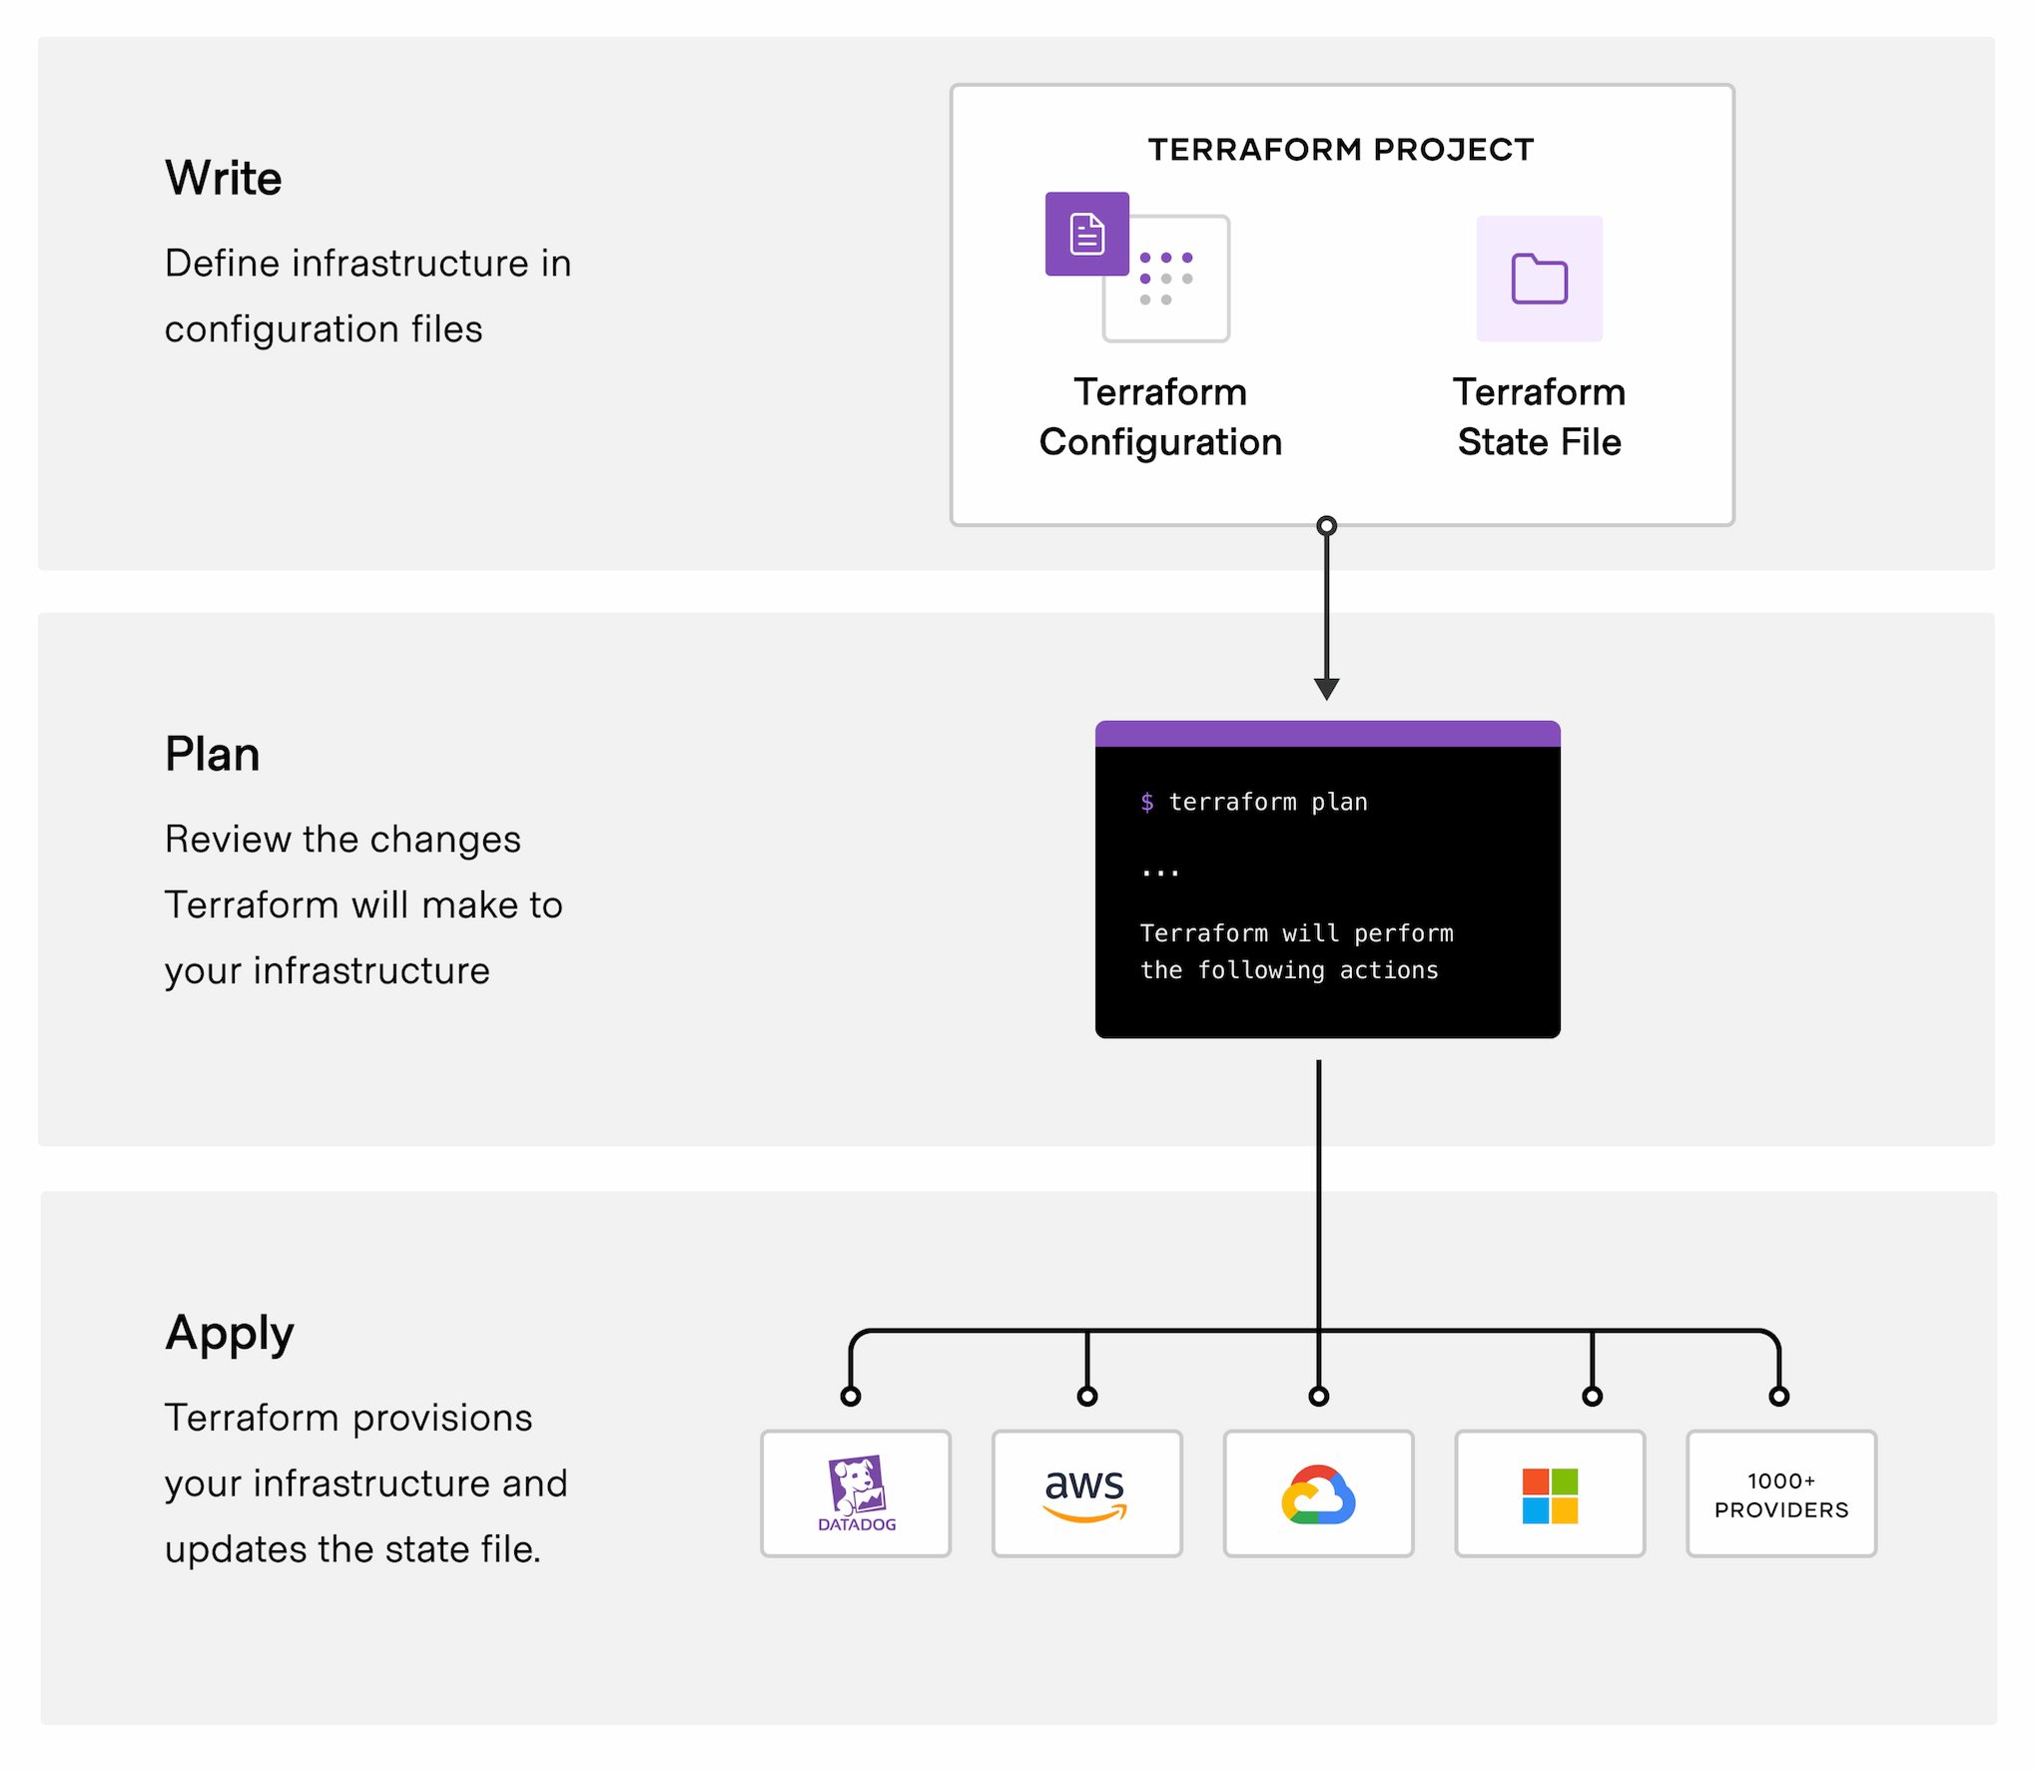
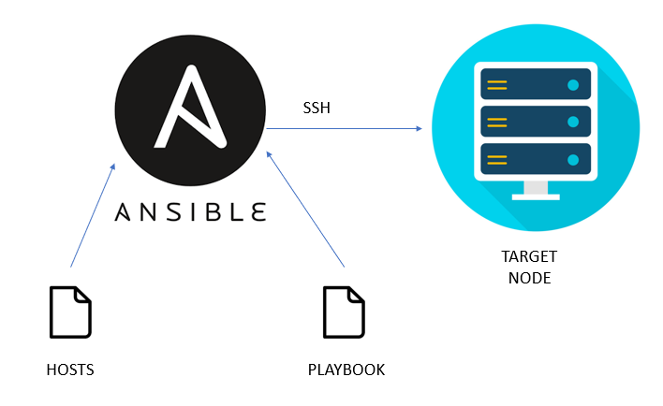
Terraform to Deploy
Ansible to Configure

Slide 11
Azure

Slide 12
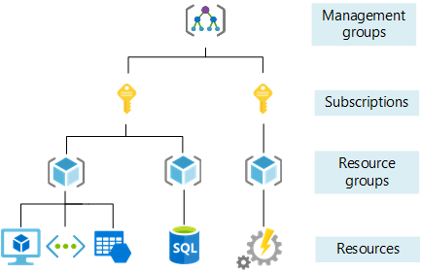
Azure Resources

Slide 13
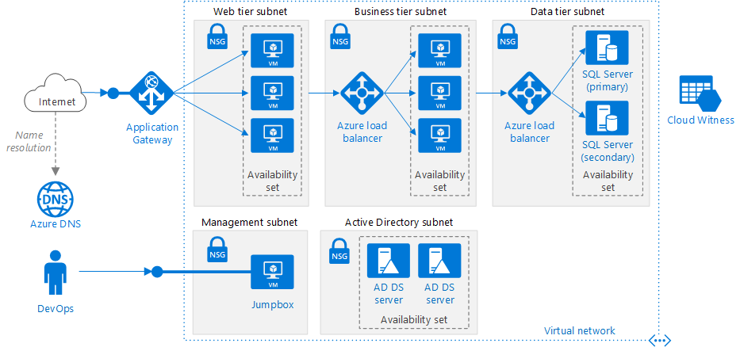
Azure Resources

Slide 14
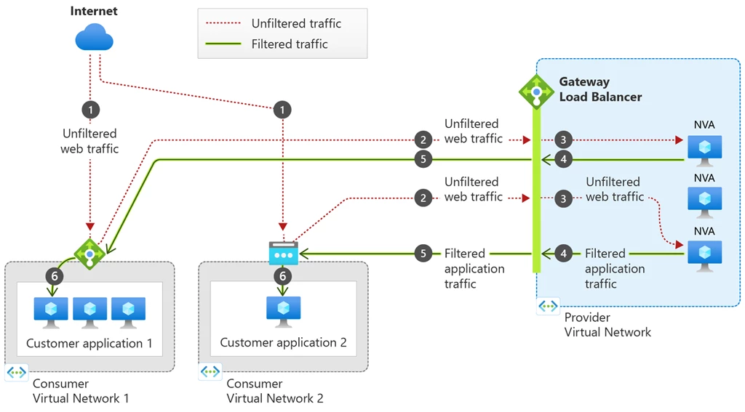
Azure Gateway Load Balancer

Slide 15
Terraform

Slide 16
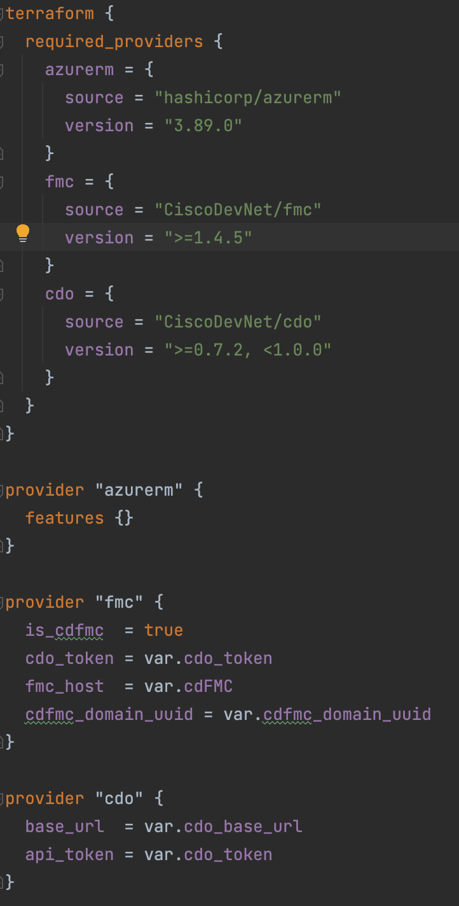
Providers
Microsoft Azure
https://registry.terraform.io/providers/hashicorp/azurerm/latest/docs
Cisco FMC
https://registry.terraform.io/providers/CiscoDevNet/fmc/latest/docs
Cisco Security Cloud (CDO)
https://registry.terraform.io/providers/CiscoDevNet/sccfm/latest

Slide 17
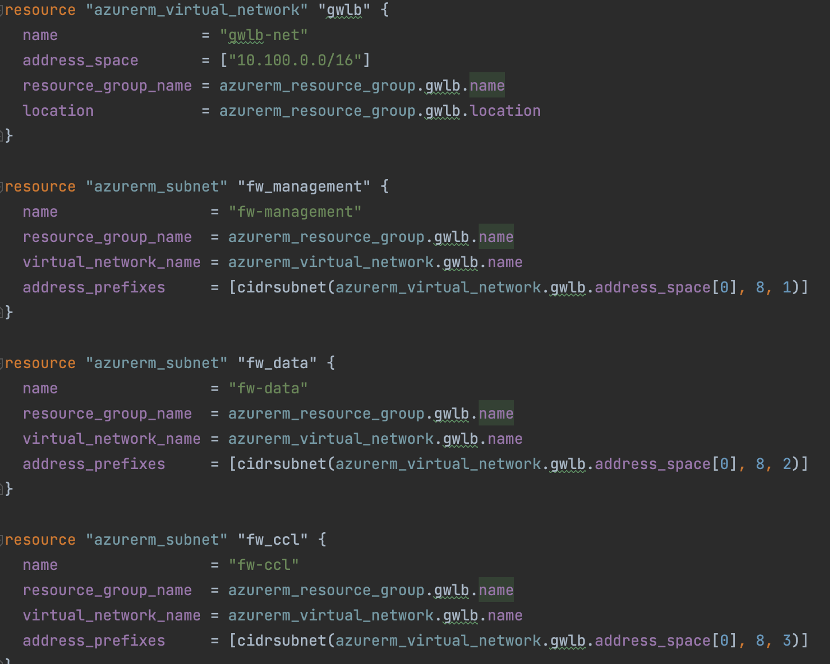
GWLB Virtual Network and Subnets

Slide 18
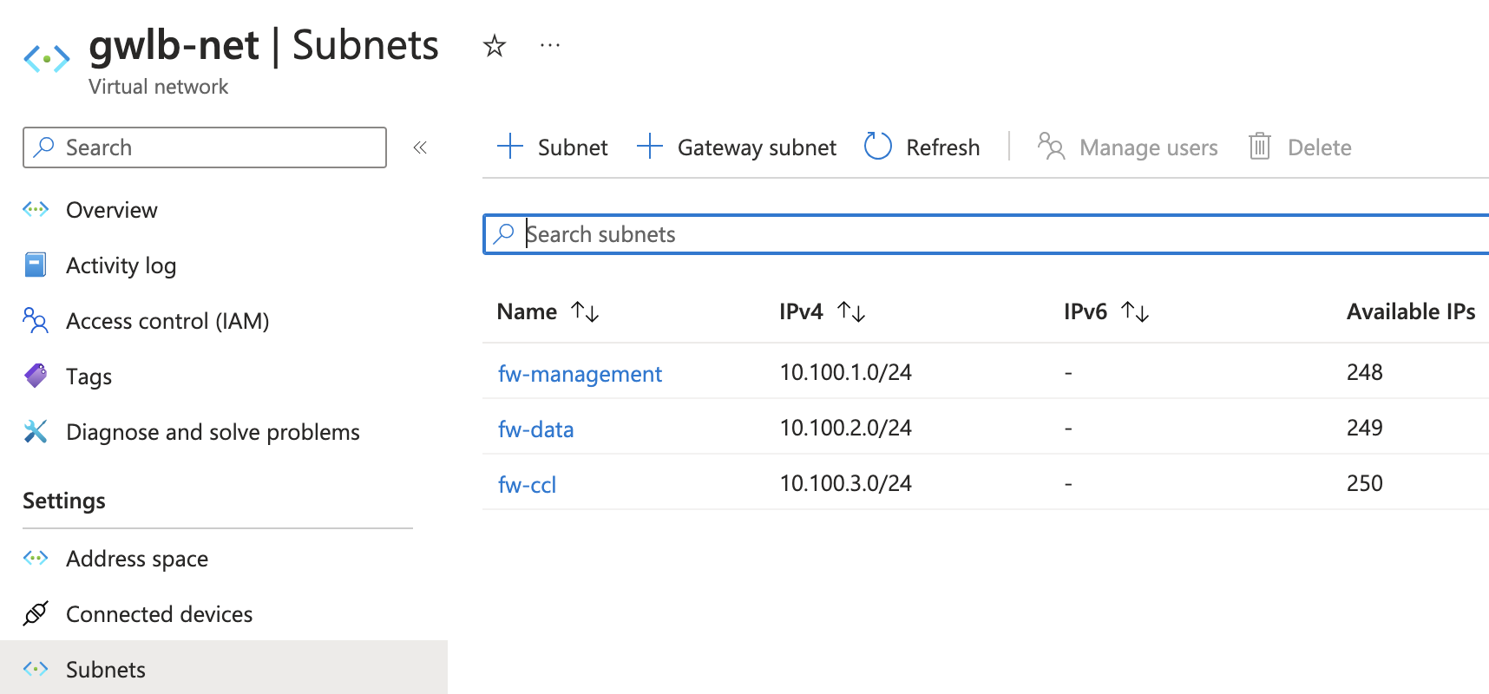
GWLB Virtual Network and Subnets

Slide 19
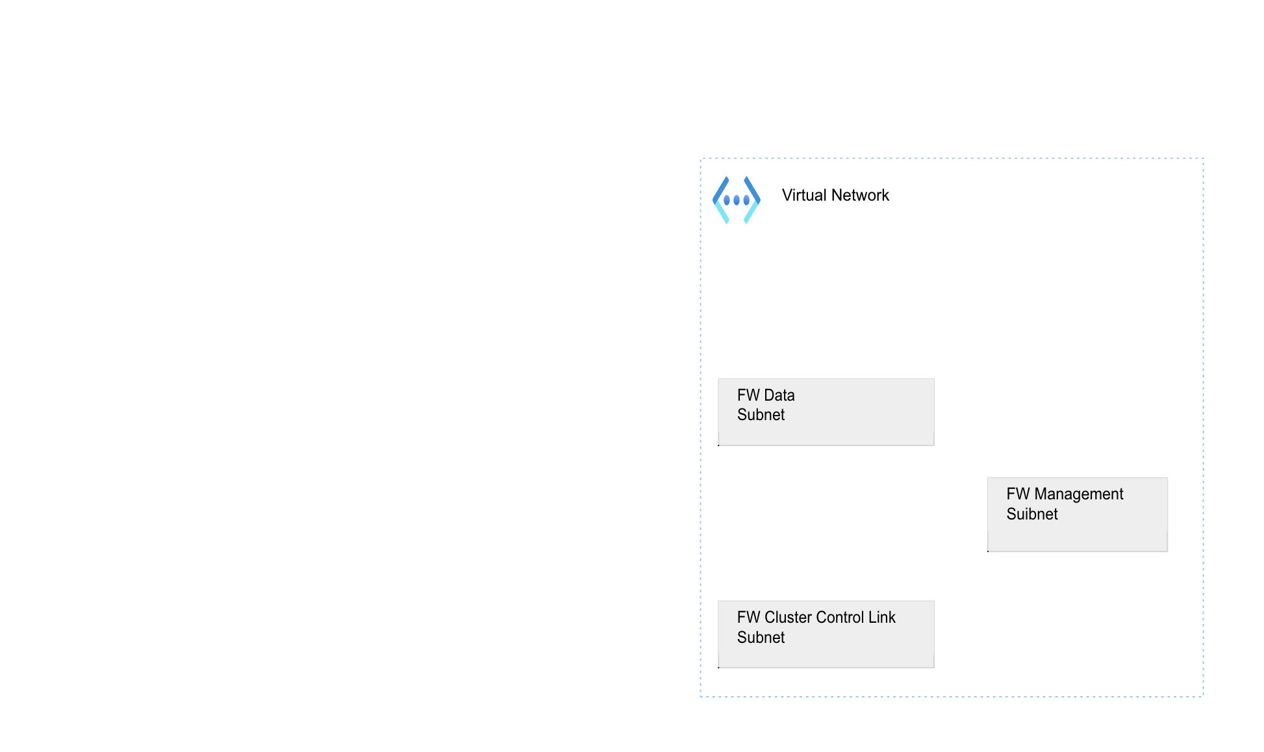
GWLB Virtual Network and Subnets

Slide 20
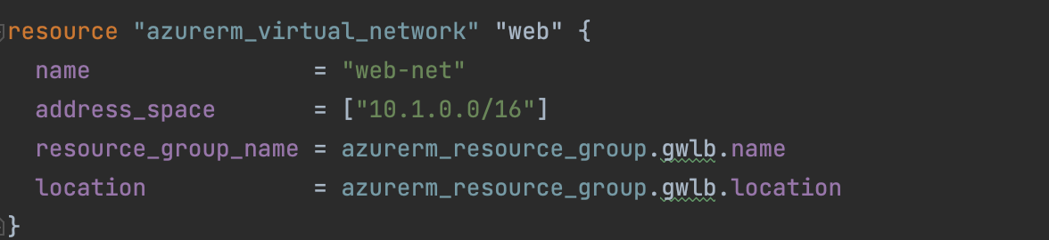
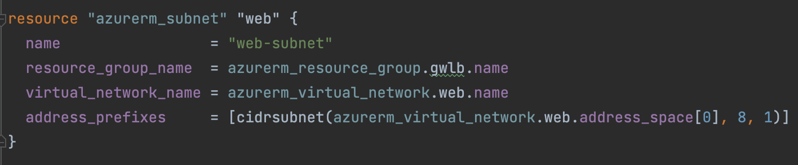
Web App Virtual Network and Subnets

Slide 21
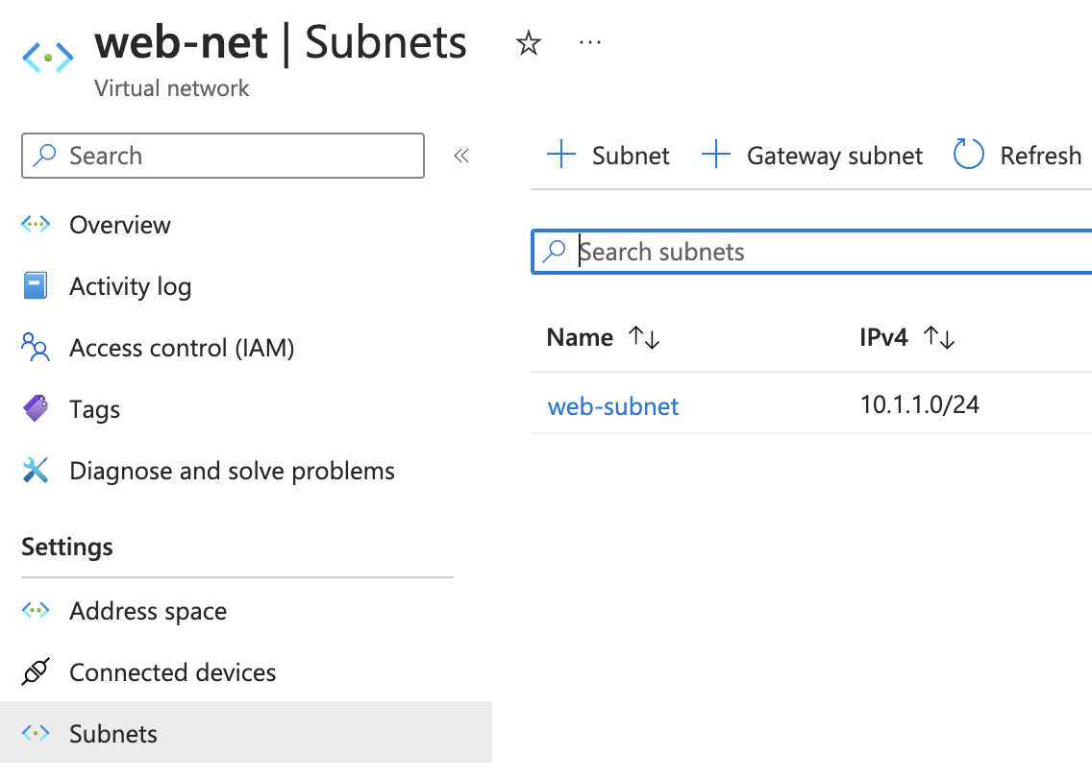
Web App Virtual Network and Subnets

Slide 22
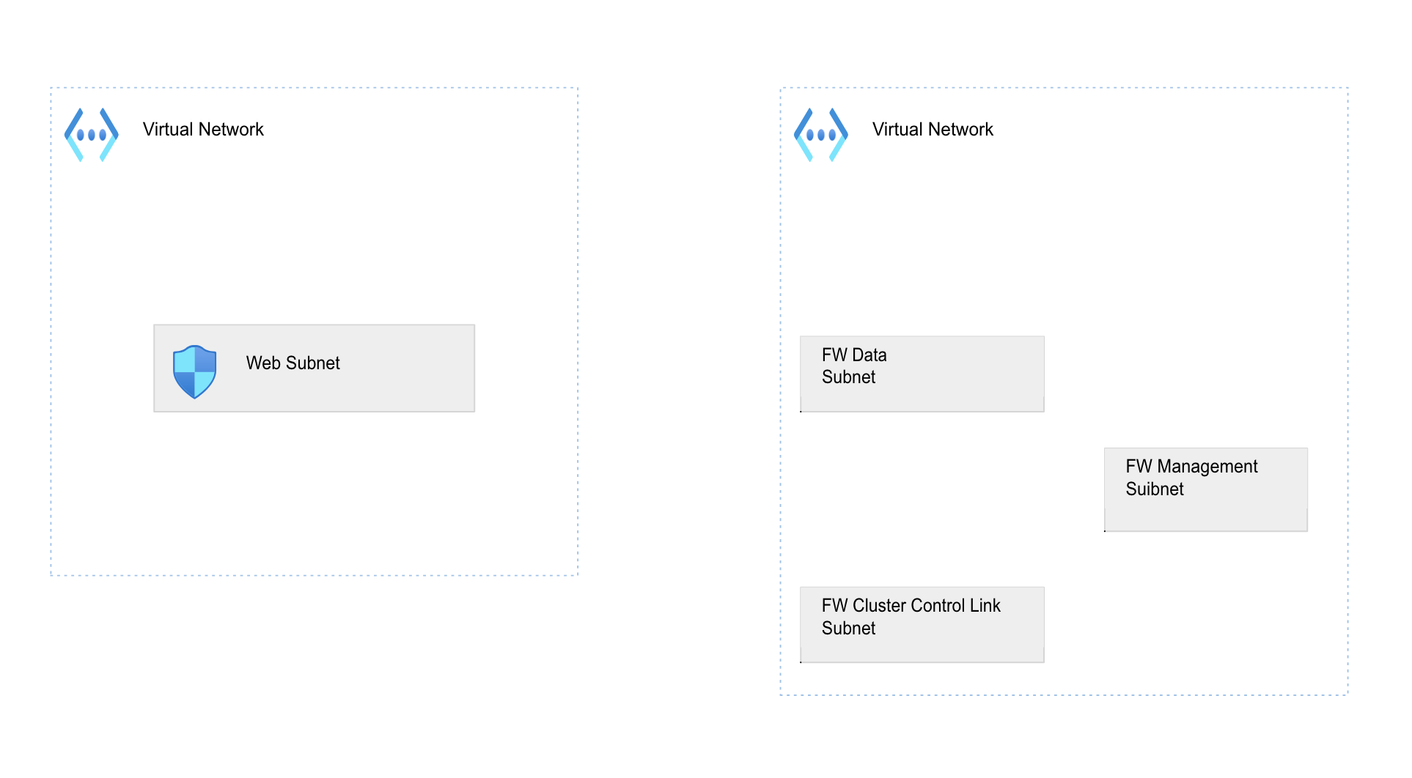
Web App Virtual Network and Subnets

Slide 23
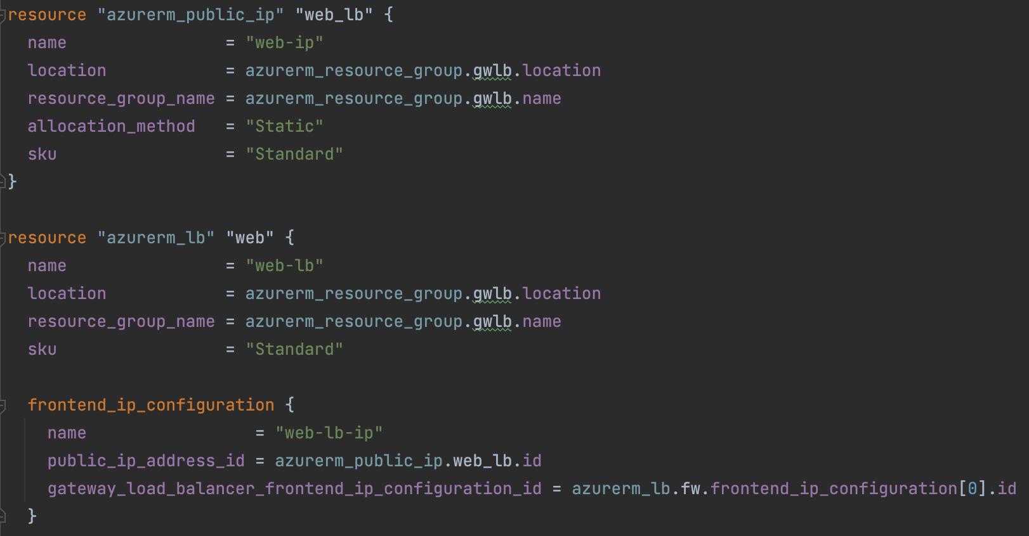
Web Facing Load Balancer in Web VNET
23

Slide 24
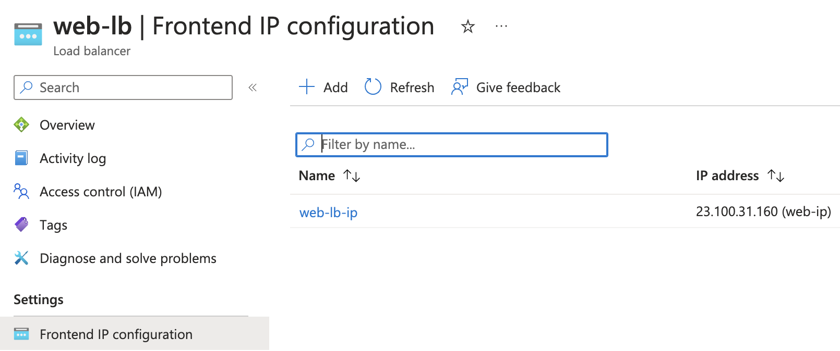
Web Facing Load Balancer in Web VNET
24

Slide 25
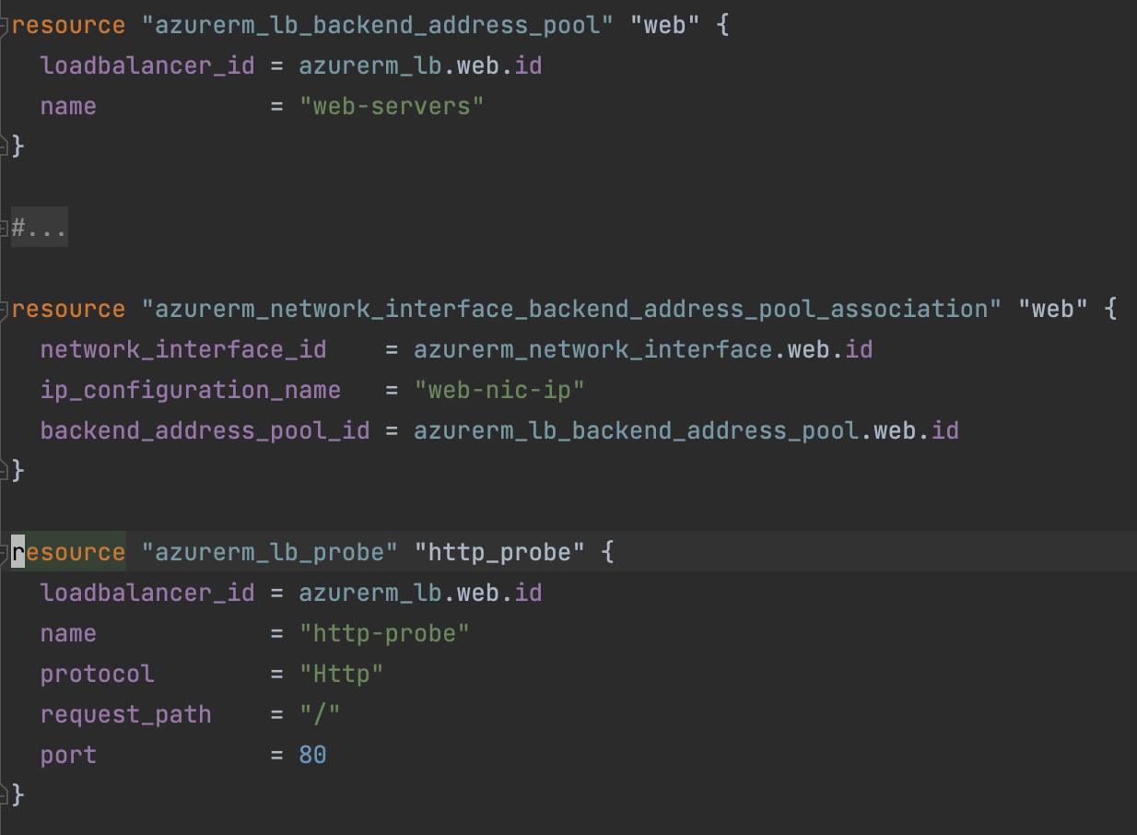
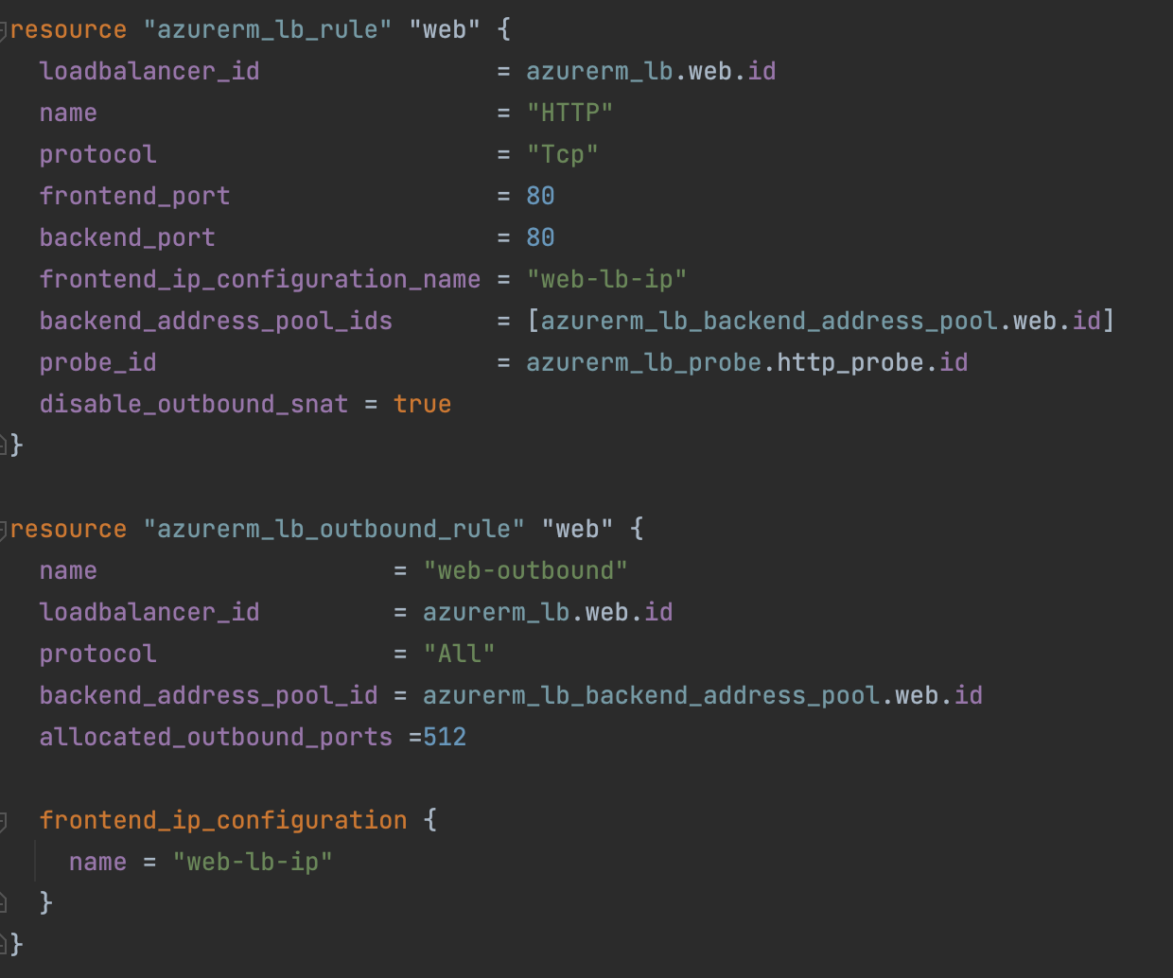
Web Facing Load Balancer Configuration
25

Slide 26
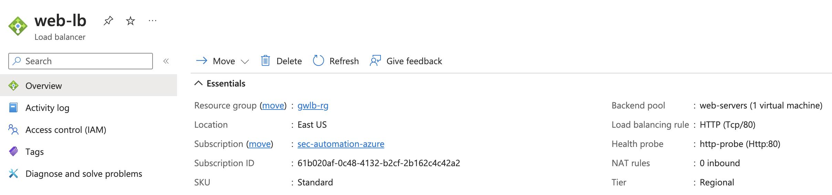
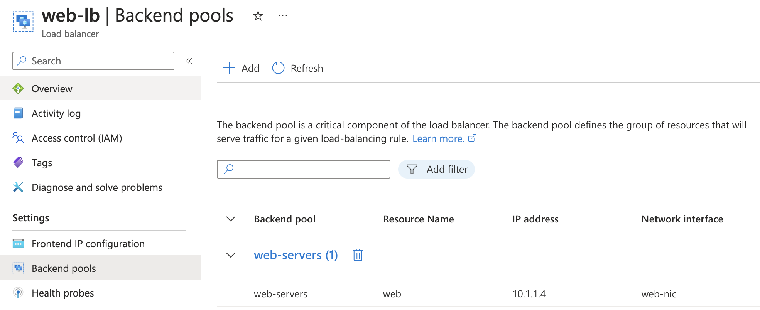
Web Facing Load Balancer Configuration
26

Slide 27
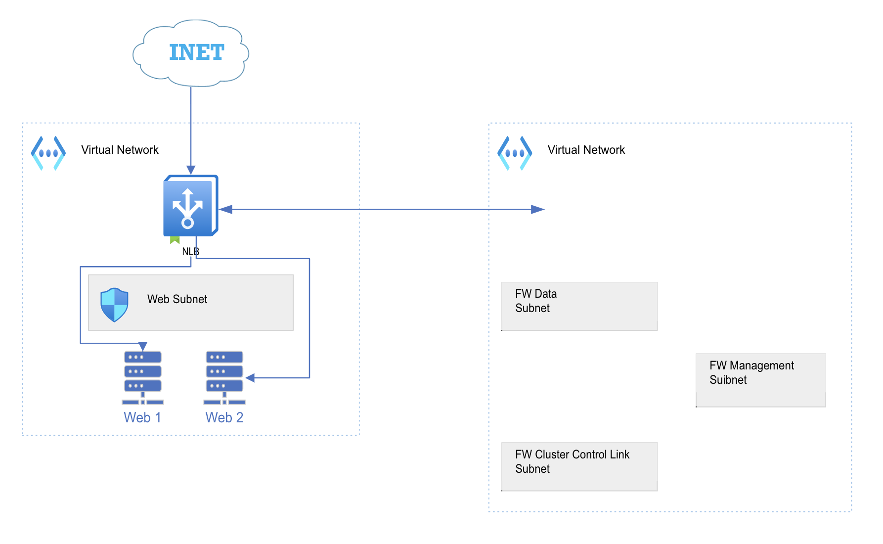
Web Facing Load Balancer Configuration
27

Slide 28
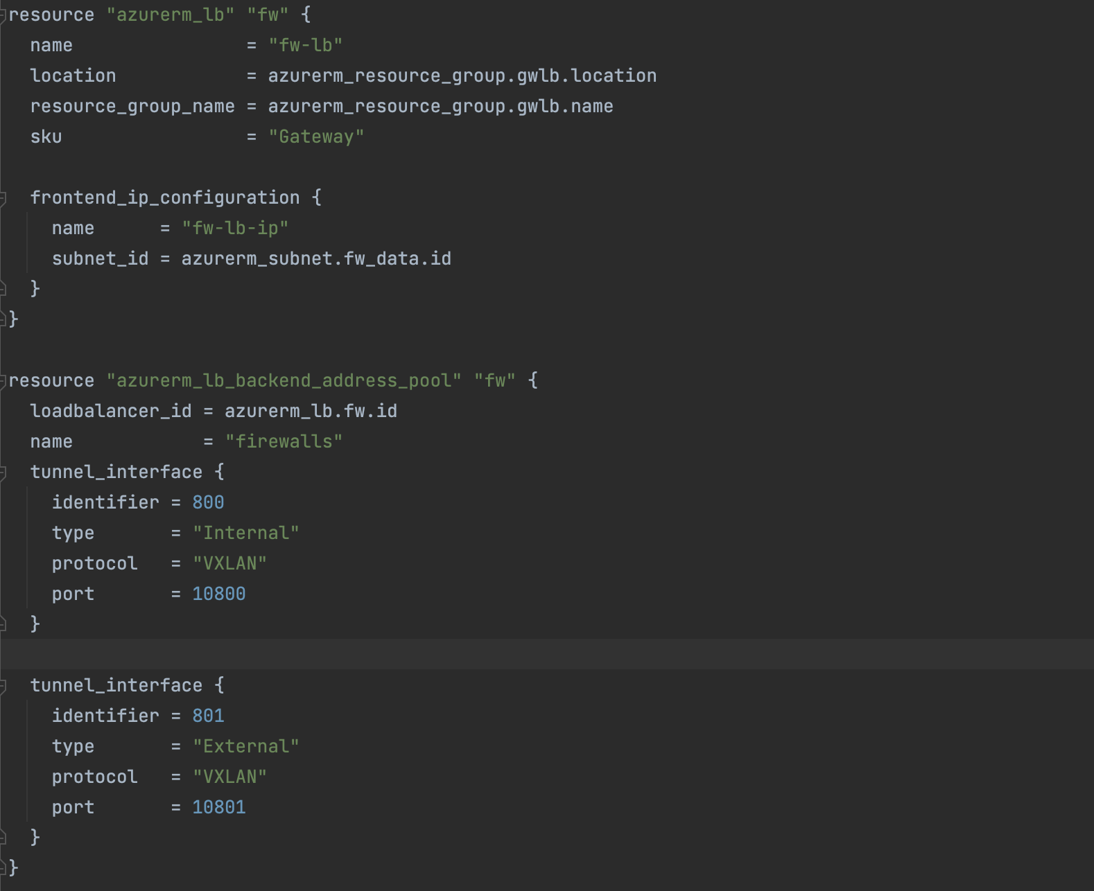
Gateway Load Balancer Configuration
28

Slide 29
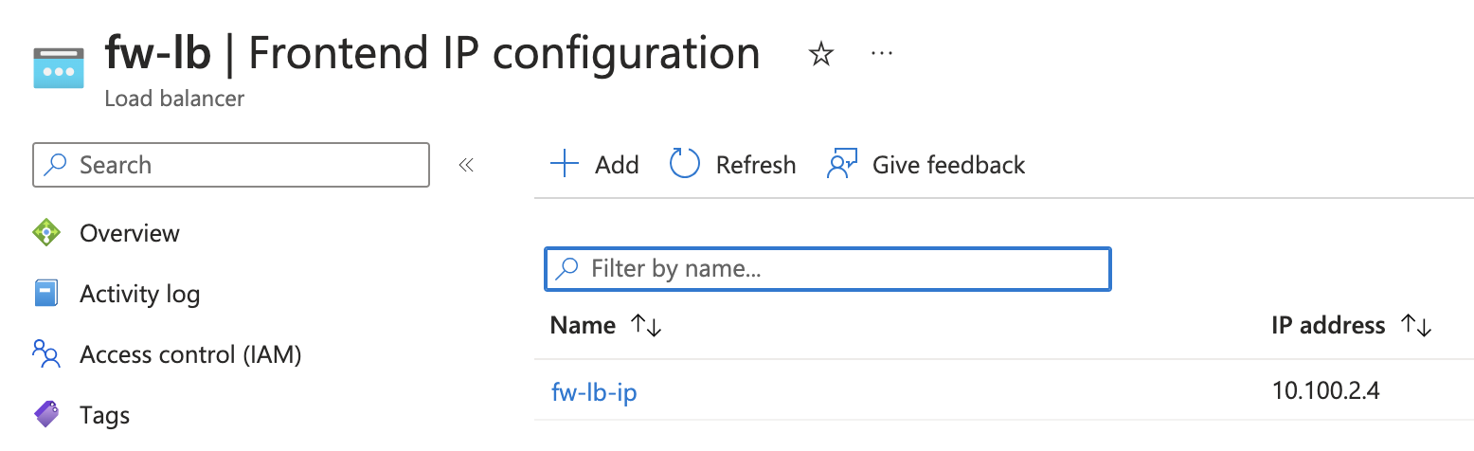
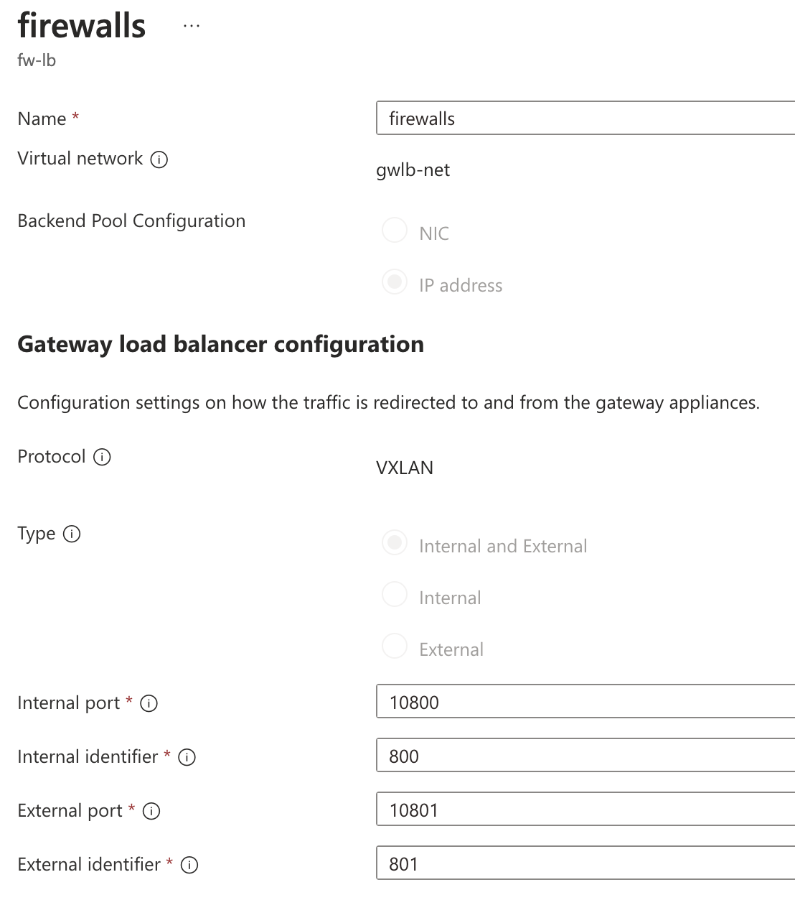
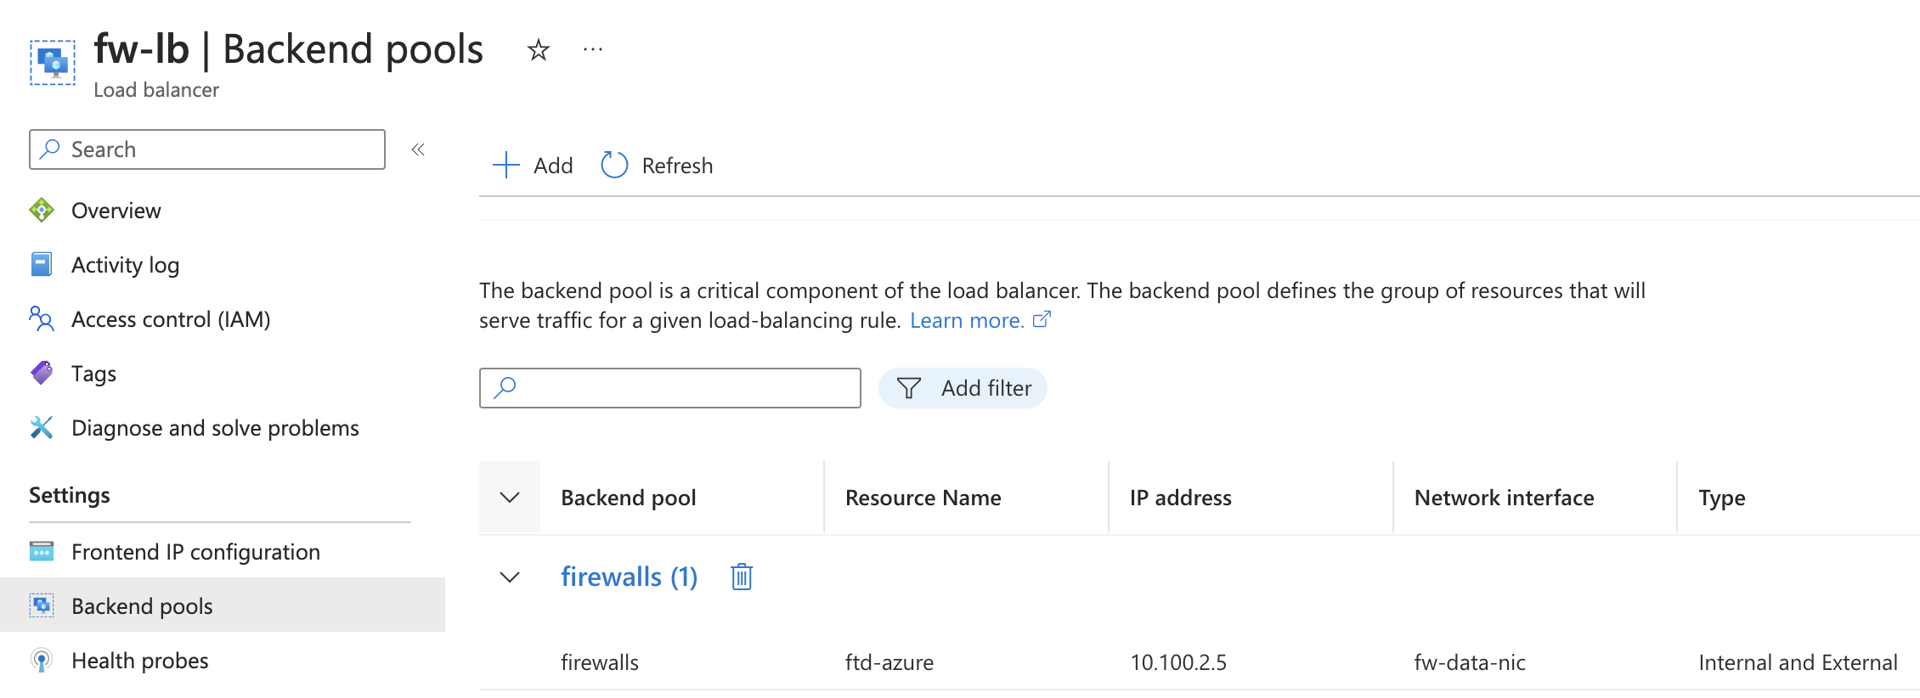
Gateway Load Balancer Configuration
29

Slide 30
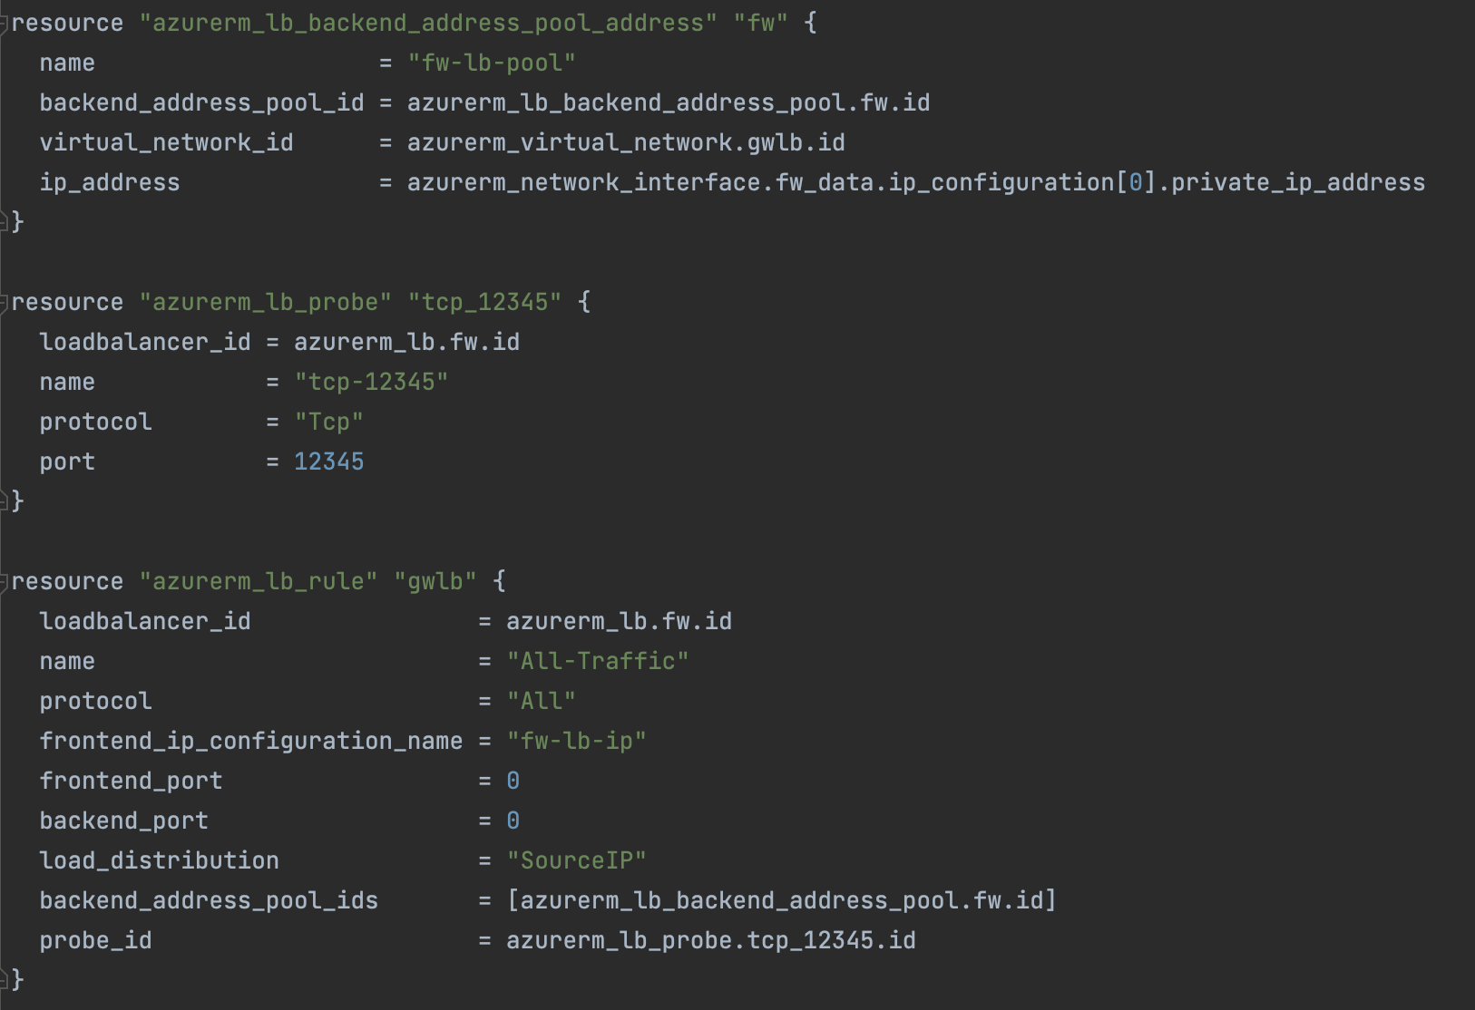
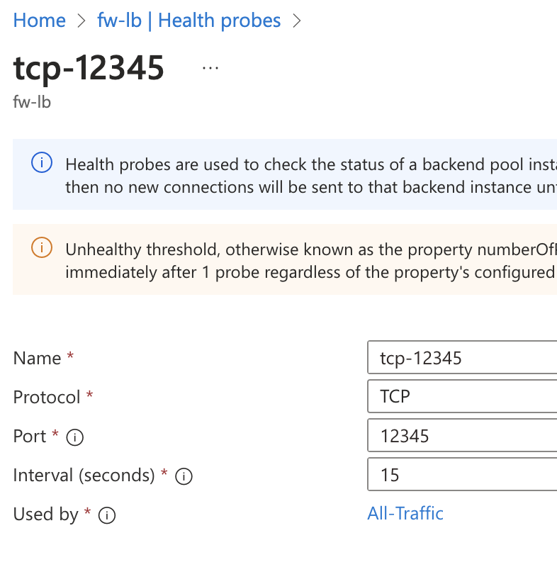
Gateway Load Balancer Configuration
30

Slide 31
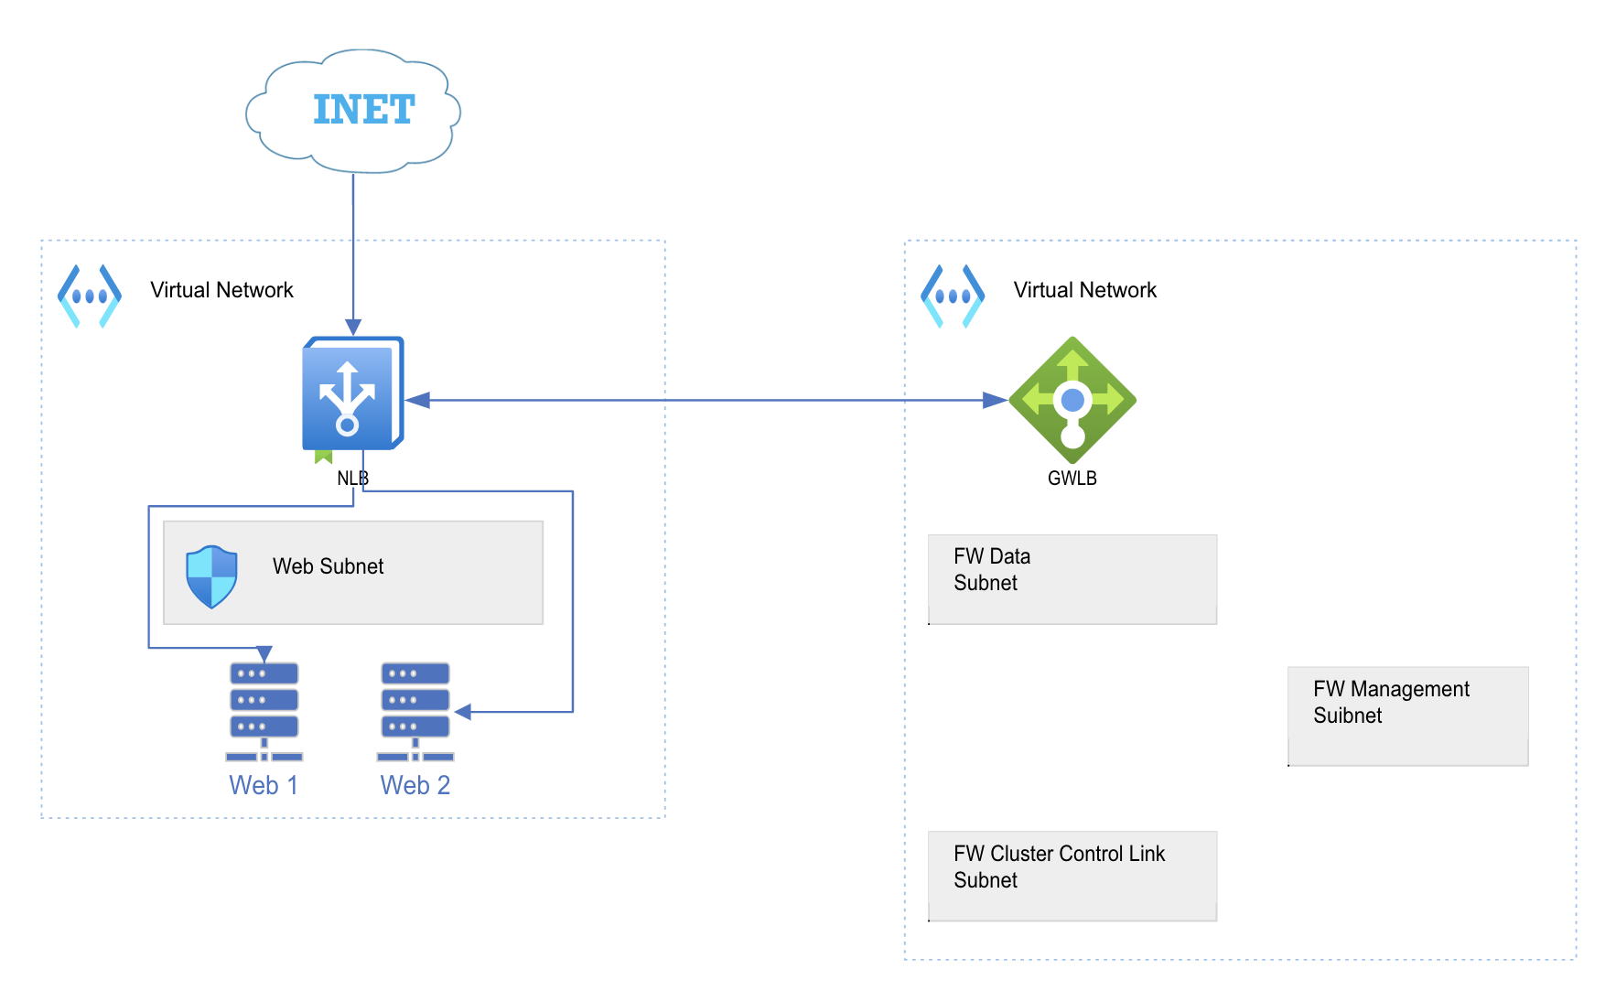
Gateway Load Balancer Configuration
31

Slide 32
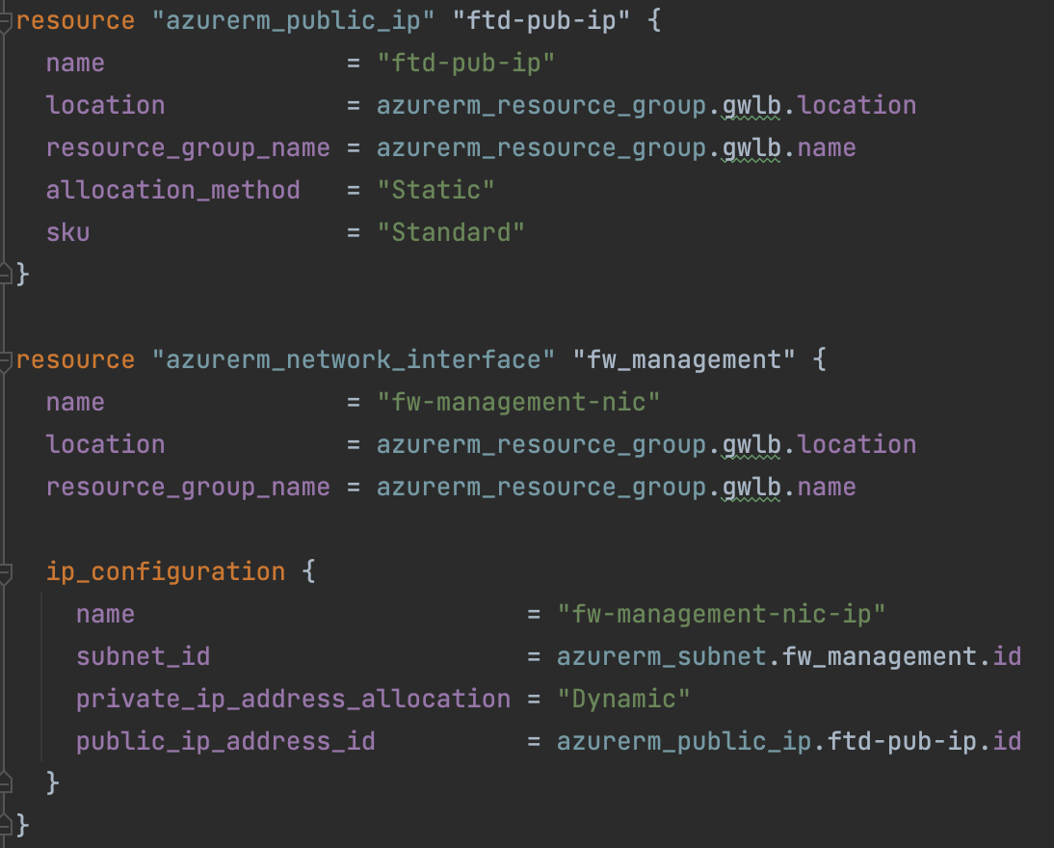
Cisco Secure Firewall (aka FTD)
32

Slide 33
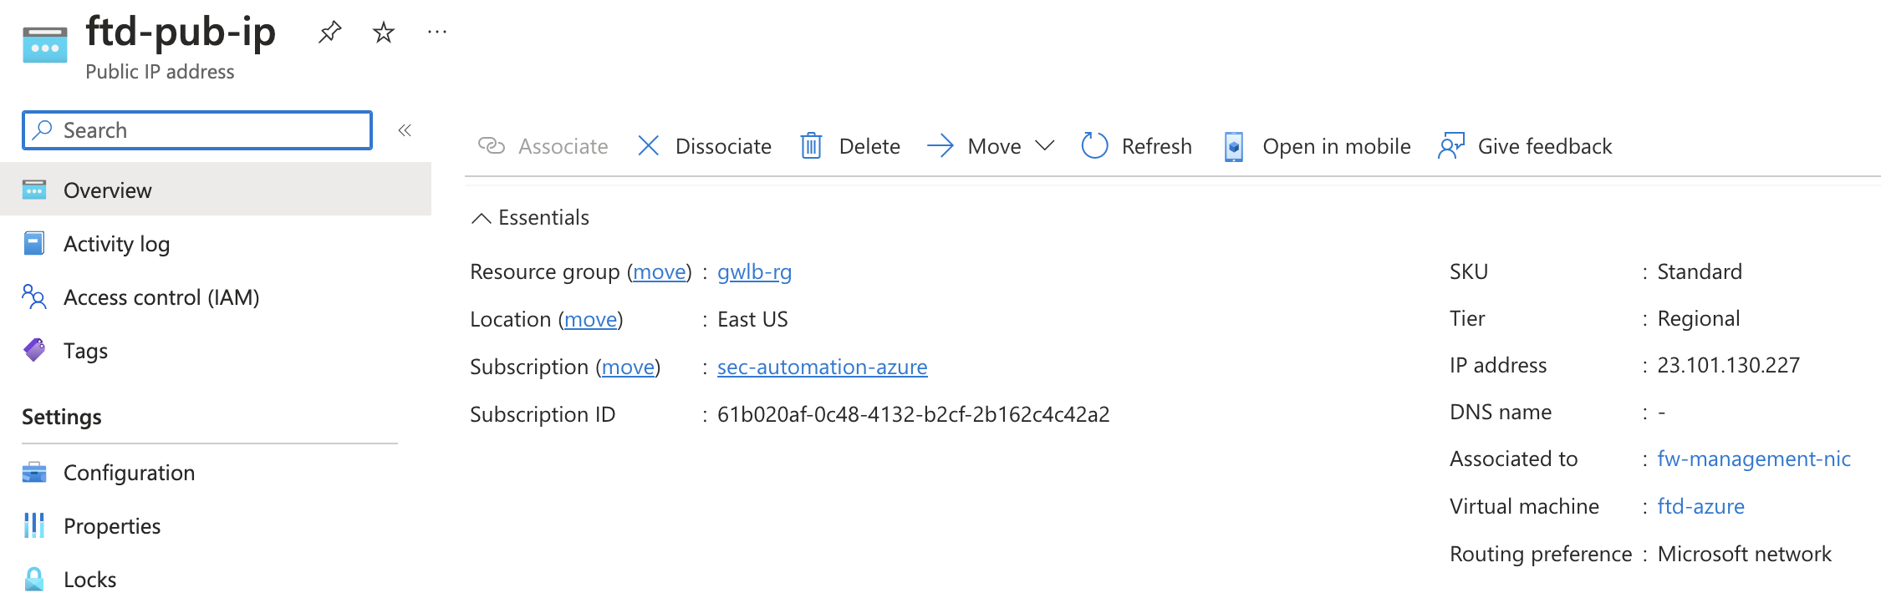
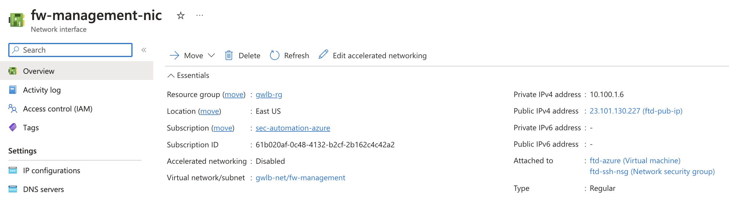
Cisco Secure Firewall (aka FTD)
33

Slide 34
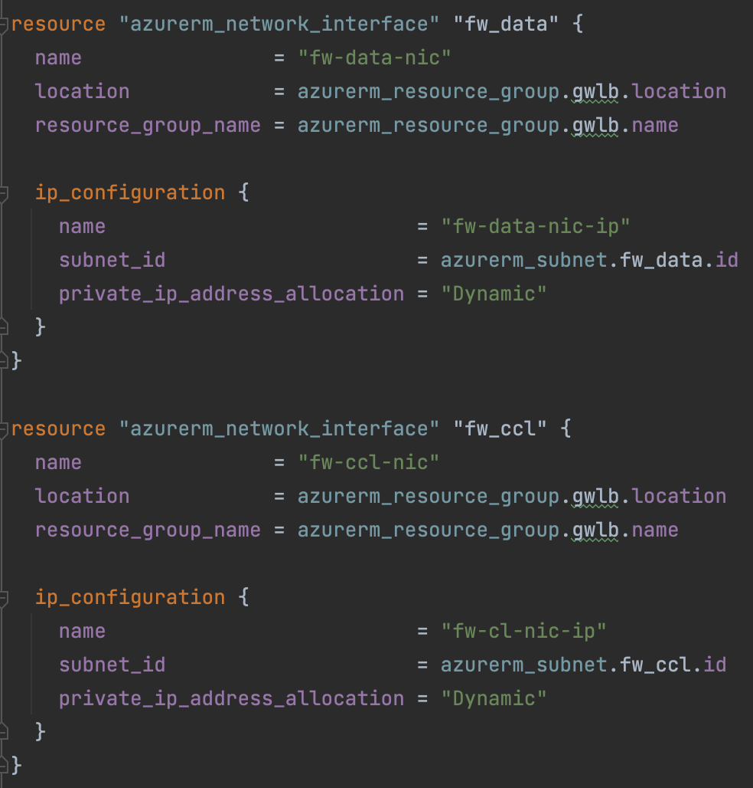
Cisco Secure Firewall (aka FTD)
34

Slide 35
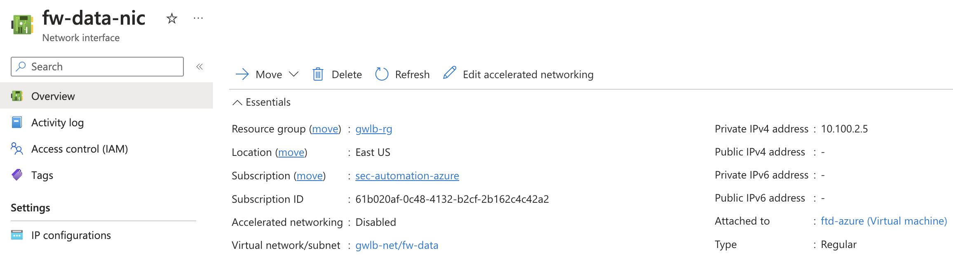
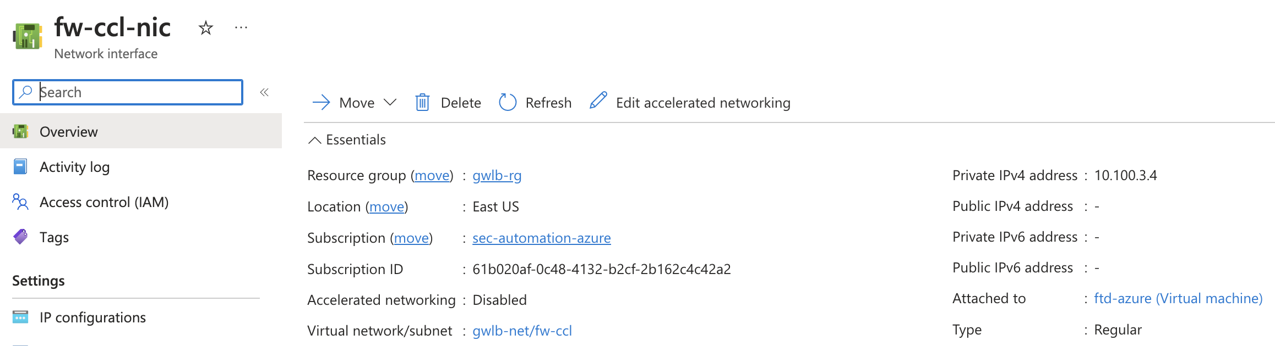
Cisco Secure Firewall (aka FTD)
35

Slide 36
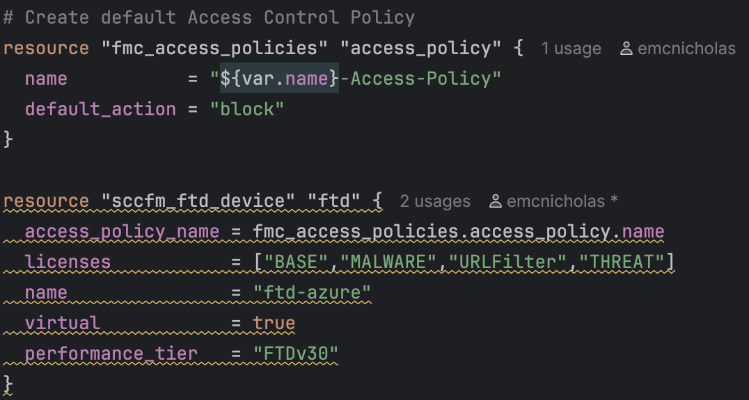
Firewall Management Center
36

Slide 37
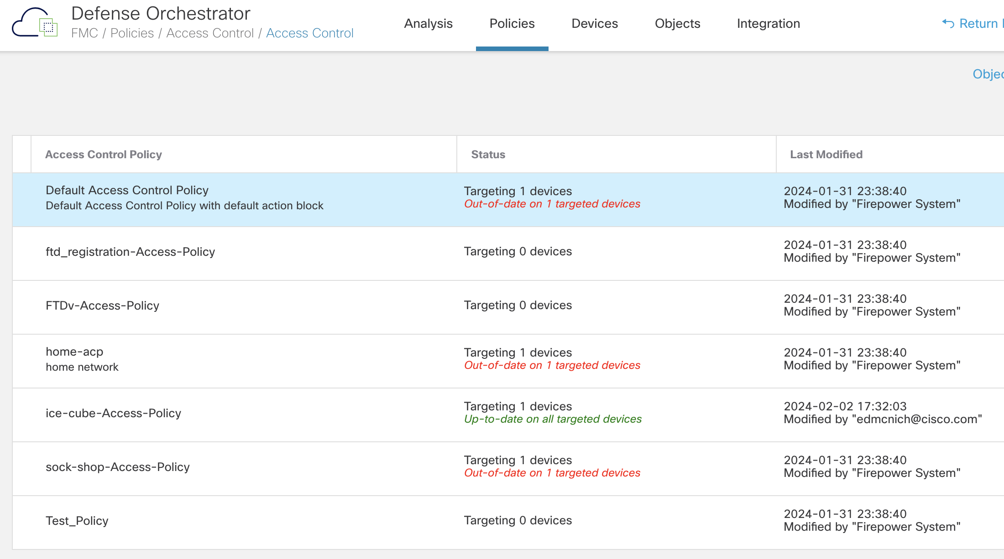
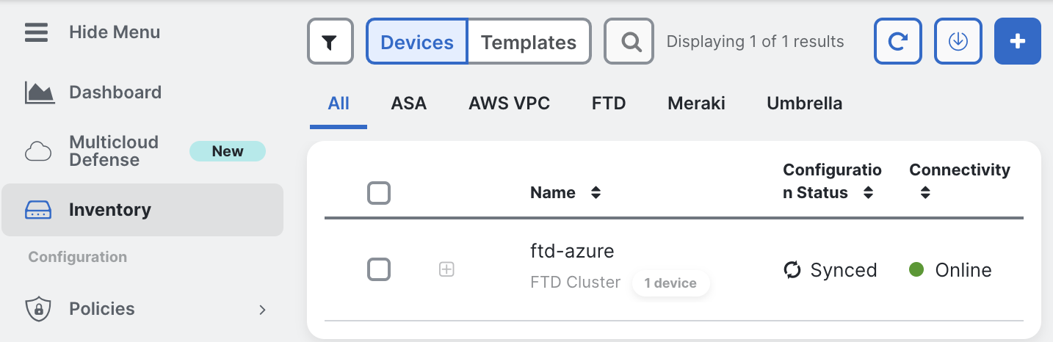
Firewall Management Center
37

Slide 38
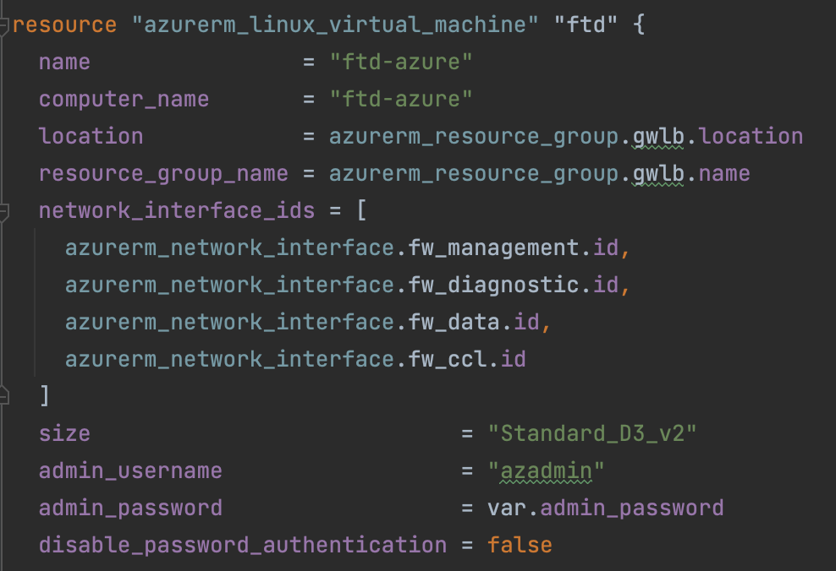
FTD Instance Configuration

Slide 39
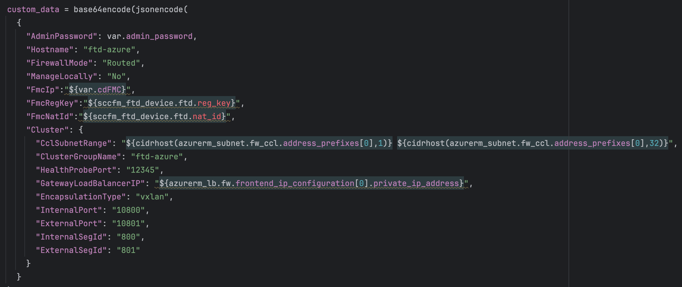
FTD Instance Configuration

Slide 40
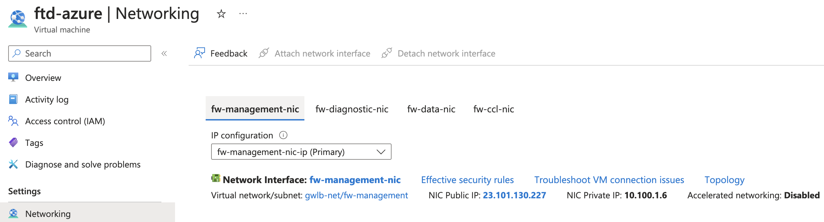
FTD Instance Configuration

Slide 41
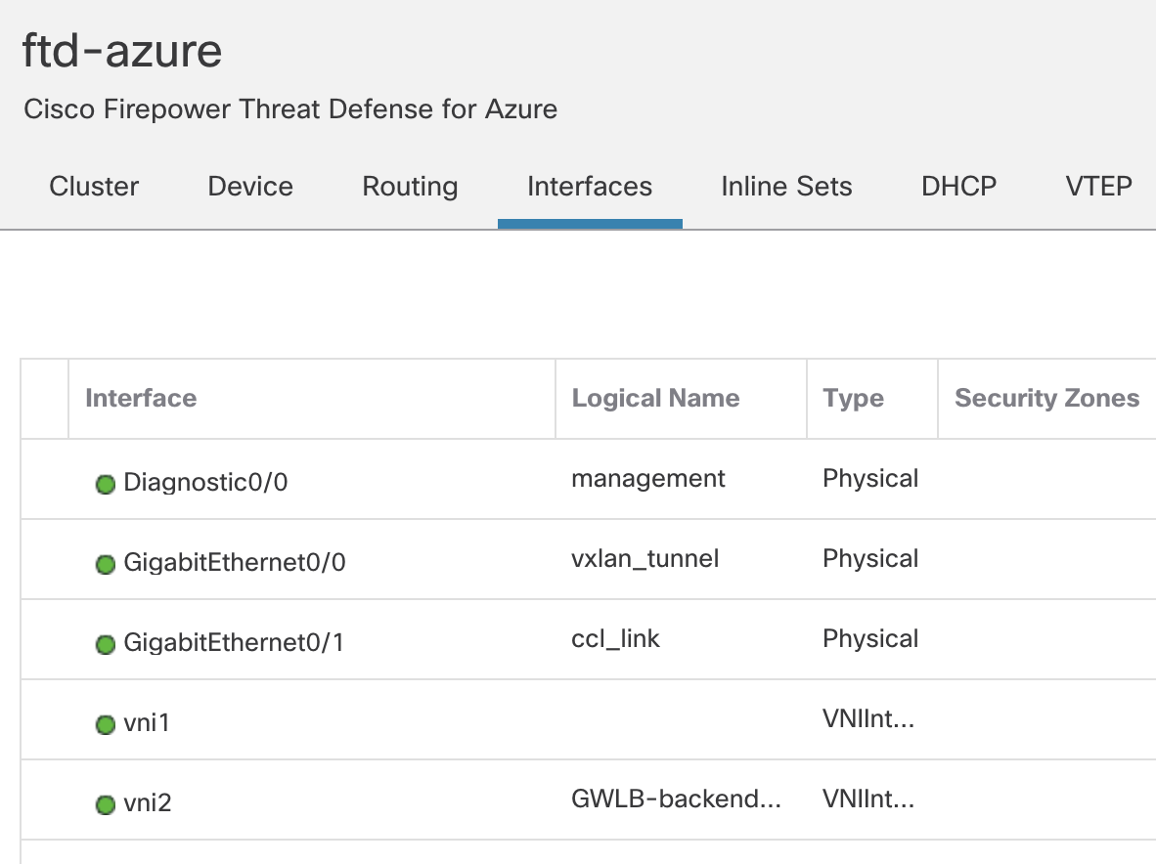
FTD Instance Configuration

Slide 42
FTD Instance Configuration

Slide 43
Ansible

Slide 44
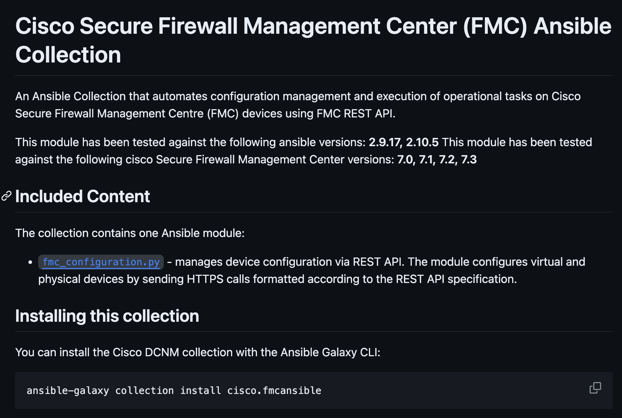
Ansible Collections
Cisco FMC
https://github.com/CiscoDevNet/FMCAnsibleCisco
Cisco Secure Cloud Control
https://github.com/CiscoDevNet/ansible-cisco-cdo/tree/main/docs

Slide 45
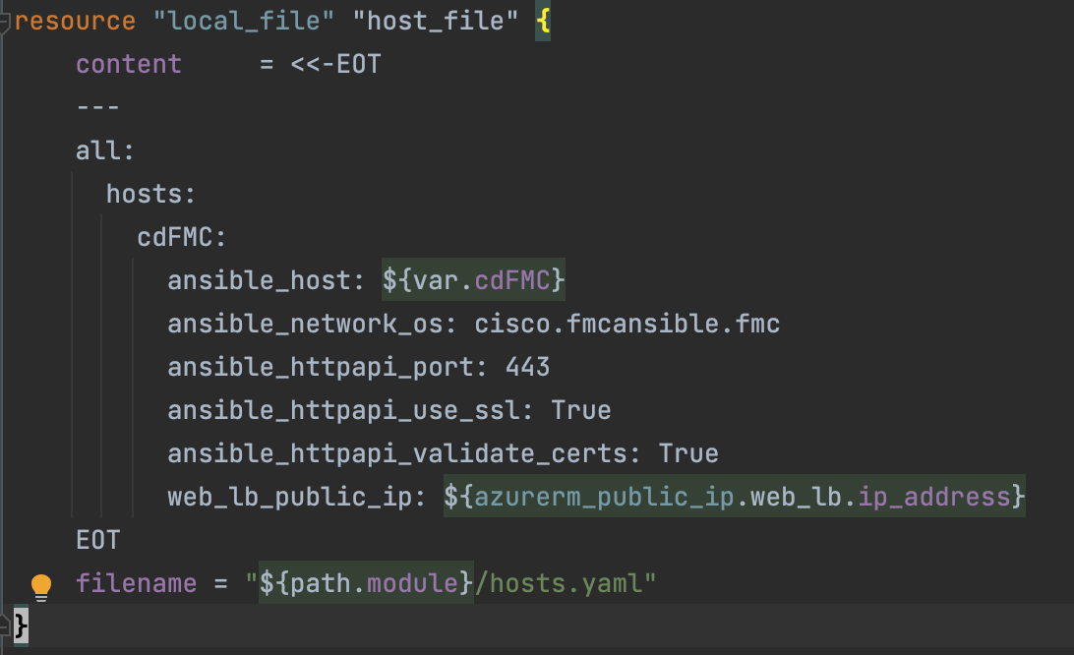
Create Inventory File from Terraform Resources

Slide 46
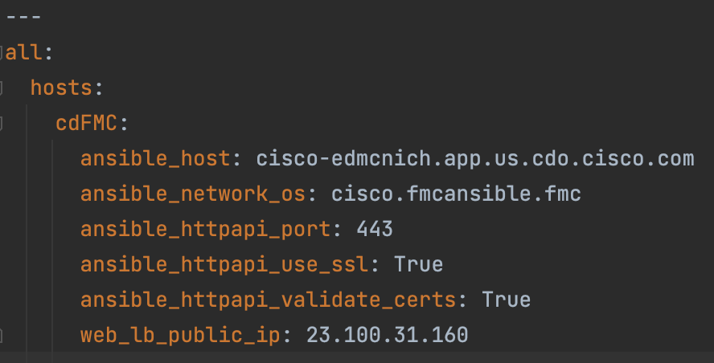
Inventory File Created (YAML)

Slide 47
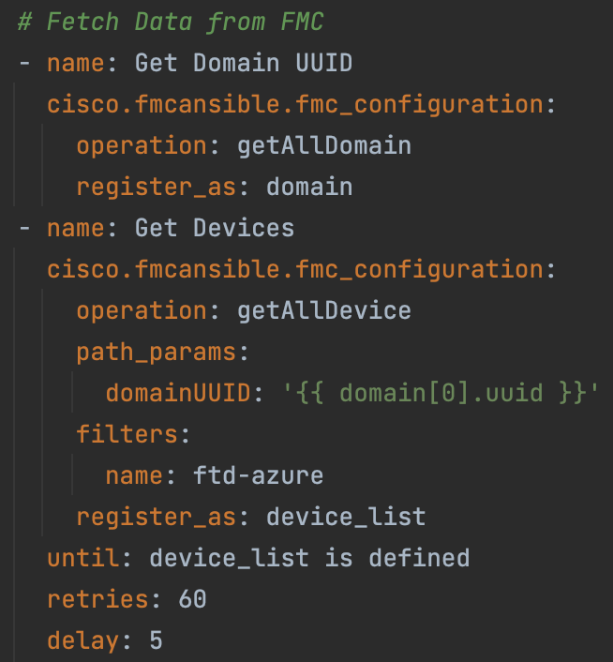
Fetch FMC Domain and FTD Devices

Slide 48
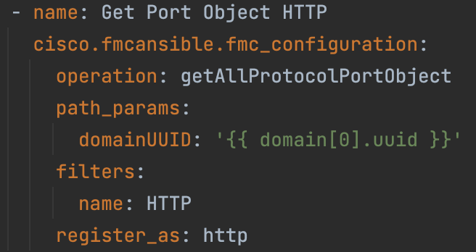
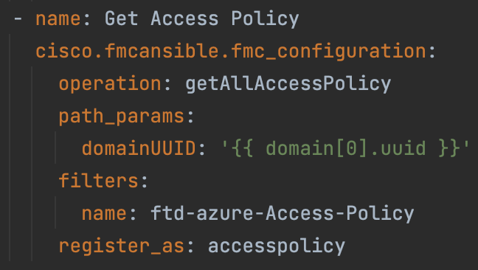
Fetch HTTP Object and Access Policy

Slide 49
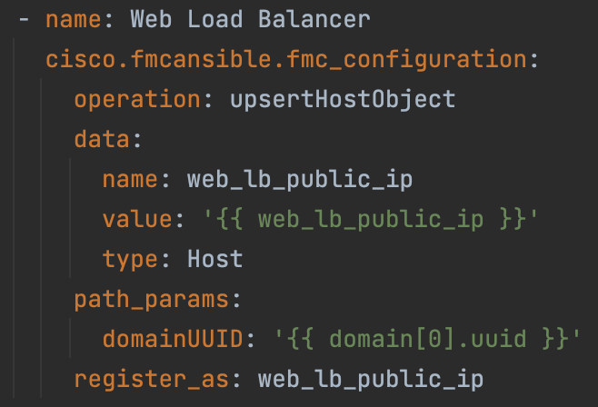
Create Host Object

Slide 50
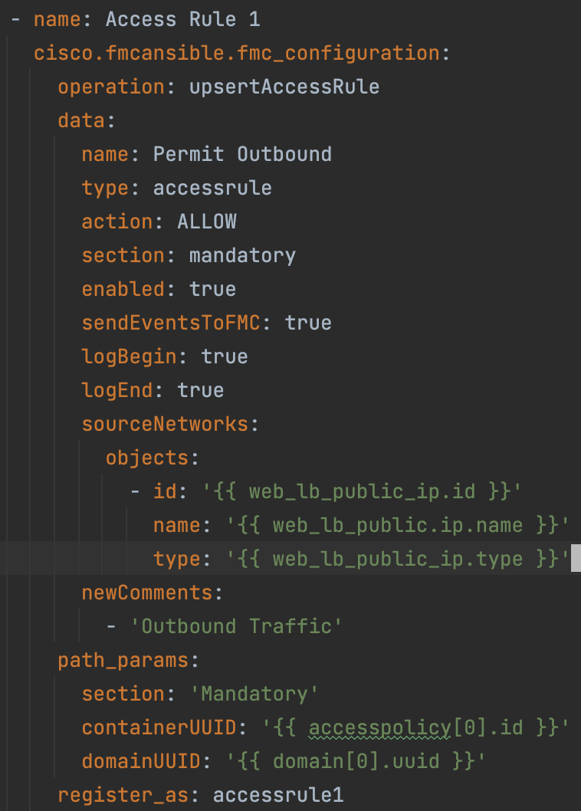
Outbound Rule

Slide 51

Inbound Rule

Slide 52

Access Policy

Slide 53
Conclusion

Slide 54
Conclusion
Provisioned Cisco Secure Firewall into Microsoft Azure using Terraform
Deployed the Firewall cluster into a Service VNET behind an Azure Gateway Load Balancer
Deployed web application into Web App VNET behind a Standard Load Balancer
Linked the Standard Load Balancer to the Gateway Load Balancer to service chain Ingress/Egress for the Web App to the Secure Firewall Cluster
Configured the Secure Firewall Policy using Ansible
Created dynamic object using Terraform resources
Created Policy rules to allow access to and from the Web App

Slide 55
Complete your session surveys
Complete your surveys in the Cisco Events App.
Complete a minimum of 4 session surveys and the overall event survey to receive a unique Cisco Live t-shirt.
(from 11:30 on Thursday, while supplies last)

Slide 56




Continue your education
Visit the Cisco Showcase for related demos
Book your one-on-one Meet the Engineer meeting
Visit the Technical
Solutions Clinics to discuss your technical questions
Attend the interactive education with DevNet, Capture the Flag, and Walk-in Labs
Visit the On-Demand Library for more sessions at CiscoLive.com/On-Demand
Contact me at: Insert preferred comms method

Slide 57
Thank you

